Slide 1
Speaknow ML
Lead Assignment
Daniel Karp 16/02/2024

Slide 2
Problem Statement
Given a data set comprising mp3 audio files, transcripts and English proficiency scores, create a micro-service that can assess fluency, grammar, vocabulary and pronunciation in speech, and grammar, vocabulary and coherence in writing.
Further tasks:
Outline how the model can be scaled for handling large-scale data
Discuss the model’s performance metrics and how to improve them over time
Provide a detailed report explaining the approach methodology, model choice and rationale
Prepare a short presentation summarizing the approach and challenges faced, and key learnings
Provide the source code in a Git repository

Slide 3
Exploratory Data Analysis

Slide 4
Provided Data
99 sound files in mp3 format:
these sound files were recordings of people answering short questions. For each person that had been asked the questions, there were 5 responses and 5 associated sound files. The sound files were named with a 16-digit number followed by a dash and then a number from 1 to 5. The recordings were made of people with varying levels of verbal proficiency, and who came from different countries.
99 records of data in csv format:
All the records were stored within a single file [SpeakNow_test_data.csv].
Each record contained 12 columns which were:
The first column (assessment_id) - corresponded to the name of the associated mp3 sound file
5 columns corresponding to the transcribed responses to each of the 5 questions asked
5 columns corresponding to the 5 assessed average metrics of verbal proficiency (pronunciation_avg, vocab_avg, fluency_avg, cohesion_avg, grammar_avg) relating to the 5 transcriptions of the associated sound file
An averaged overall measure of verbal proficiency called CEFR_avg which relates to the Common European Framework of Reference for Languages, an international standard for describing language ability.

Slide 5
Data Notables
Data File:
33 assessment id’s have no transcriptions recorded against them
The cefr_avg metric is not obviously derived from the pronunciation_avg, vocab_avg, fluency_avg, cohesion_avg, and grammar_avg metrics
These metrics are averages of scoring all 5 transcripts in the given record, which are all recorded by the same person
Sound Files:
One sound file appears to have no audio: 1692746758560938-1.mp3

Slide 6
Approach
Searched through online research (Google Scholar) to see what current approaches to this problem might be.
→ Found that there was some work involving machine learning approaches, mainly CNN’s and RNN’s.
→ Couldn’t find much around scoring that didn’t involve a hybrid human/machine approach.
Decided to find a means of accurately transcribing the mp3 files as this would anyway be required when providing an inferencing service.
→ Tried many different approaches:
  Google Recognize 3.10.1 (Google)
  DeepSpeech 0.9.3 (Mozilla)
  vosk-model-en-us-0.42-gigaspeech & vosk vosk-model-en-us-0.22-lgraph (alphacephai)
  HuggingFace wav2vec2-base-960h (Meta)
→ But… ChatGPT Whisper-1 (OpenAI) was by far:
  the easiest to implement
  the fastest to setup
  the most accurate without much training
  the quickest to run (and didn’t crash my machine)
  but costs money (a fraction of a cent per api call)

Slide 7
Analysis
Divided up the problem into 2:
Analysis of audio files in association with their model-generated transcripts (Whisper-1)
Analysis of the provided transcripts
Feature Engineering
Researched the most common audio-file derived and text-derived metrics that would be appropriate for use in a model that needed to assess both writing and speech. These were as follows:
Audio file derived metrics:
- Formants: Resonant frequencies of the vocal tract --> flattened into mean, median, std, min and max
- Pitch: Fundamental frequency (F0) of the speech signal
- Intensity: Energy level of the speech signal
- Speech rate: Number of words spoken per unit time
- intensity to speech rate ratio: Intensity/Speech rate
- Pauses duration: Total duration of pauses in speech (in seconds)
- Pauses frequency: Frequency of pauses in speech (number of pauses per second)
- Audio duration: Duration of the audio signal (in seconds)
- Mel-Frequency Cepstral Coefficients: (mean, std, var) small set of features describing the spectral envelope
- Spectral centroid mean: measure of amplitude as the center of the signal spectrum
- Spectral bandwidth mean: measure of significant radiated spectral quantity

Slide 8
Feature Engineering contd…
Transcript derived metrics:
- Brunets Index: gives an idea of the lexical diversity of the text
- Average sentence length
- Text cohesion: how well the words in a text are integrated or linked together in meaning (GloVe 6B (100d) used here)
- Flesch-Kincaid Grade Level: takes into account syllable count and sentence length to assess readbility
- Coleman-Liau Index: takes into account word length and sentence length to assess readability
- Automated Readability Index: assesses the U.S. grade level required to read a piece of text
- Repetitions: How many repetitions are detected in a text
- Filler words: Counts the filler words used in the text
The feature engineering continued as follows:
2 file extracts were generated:
To serve as the speech-based dataset
To serve as the written-text-based dataset
Separate Data files were extracted to serve each model type.

Slide 9
Modelling
Separate Python scripts (Jupyter Notebooks) were created to build models for each of the speech and written transcriptions. The idea was to predict the average CEFR score.
In each notebook, several models were tested. These included:
RandomForestRegressor
GradientBoostingRegressor
XGBoost
BertTokenizerTransformer
An iterative Grid Search approach was used to identify the hyperparameters that optimized the models.
It was found that the GradientBoostingRegressor model outperformed the others by a small margin, but not significantly.
A CEFR was also approximated for each transcription using alphabetic notation (A1, A2, B1, B2, C1 C2), and from there converted to a numeric score. This approach did not appear to be particularly effective.

Slide 10
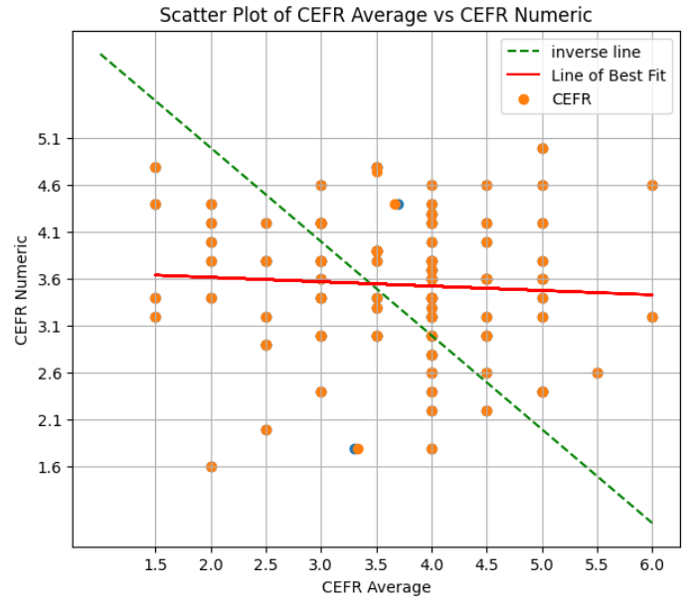

Modelling

Slide 11
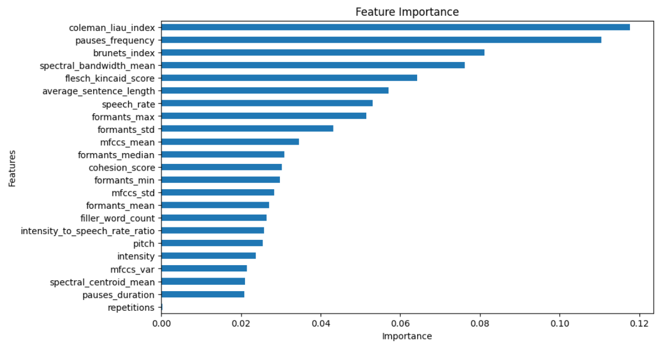

Modelling
The models were assessed for feature importances. The GradientBoostingRegressor that was tuned using GridSearchCV resulted in the following:

Slide 12
Findings
It appears that the audio itself is required for a much more accurate prediction of CEFR, with an R² of around 0.6 compared to an R² of around 0.3 for the text-only predictions. This also indicates that not all the differences between the CEFR’s could be explained by the data. It is likely other features are required, or further preprocessing of the transcriptions are required.
The provided transcriptions did miss some words, and had mistakes in others, indicating that they were likely transcribed by a language model of some description.
Although the ChatGPT Whisper-1 model was excellent in transcribing mp3 audio to speech, the non-fine-tuned version missed out many of the filler words, which would have more of an impact on fluency.
The CEFR score does appear to have a relationship to the attributes inherent in recorded speech, especially when including both audio and text features.

Slide 13
Next Steps
Improve the transcription process by fine-tuning the whisper-1 model to notice more of the filler words.
Engineer more features in the dataset related to especially grammar and fluency.
Increase the number of audio recordings on which to train the model.
Test how neural networks perform, such as an LSTM model which have been cited as somewhat effective in this space.
Actually implement a micro-service allowing the selected model to be tested more widely

Slide 14
Appendices

Slide 15
Actual – when listened to
Um no, I don't want to be on a reality show. And the main reason why is because I really want to I really take care of my privacy eh I don't want the people all around me, especially outside of my neighborhood or my city or at work. I don't want them to know about me any more than what I want to give or to show I prefer to leave it like that and to make my friend and my way on my way.
um my favorite social media platform that I prefer is uh facebook and I prefer because there is a lot of things that you can see from comedy shows that you can laugh and relax at the end of the day and also you can look for work, that's how I found this job. Um there's a lot of opportunities to see outside of your own eyes, uh to open your mind to see other things that might be that you might be curious about and that's why I prefer that platform. And also I can I can put and use this platform um and also keep my privacy, I can choose whatever I want to show, I can choose whatever I want to to see and that's why I prefer that.
Uh I prefer to work every day in a few hours um because I like to get up in the morning, getting dressed, come to the office, talk to people. I prefer to see how I can do more at work every day and only on shabbat and on friday to have a relaxing day that I can do whatever I want to.
I prefer to invert to invert or a drug because the most of the things that I believe in my life is saving savings people life. Um and if I can help with that, it will be the most happiest thing I can ever give to the world and to myself that I achieve something and I can also do something in my life.
wow, that's a very hard question because I like the way I live now. Um I'm not saying that I'm perfect, but I prefer to live my life as it is simple er with no superpower, um I really like my the way I'm living and I hope that it will be better without a superpower.

Slide 16
Provided
Um no, I don't want to be on a reality show. And the main reason why is because I really want to I really take care of my privacy and I don't want the people all around me, especially outside of my neighborhood or my city or at work. I don't want them to know about me any more than what I want to give or to show I prefer to leave it like that and to make my friend and my way on my way.
um my favorite social media platform that I prefer is a facebook and I prefer because there is a lot of things that you can see from comedy shows that you can laugh and relax at the end of the day and also you can look for work, that's how I found this job. Um there's a lot of opportunities to see outside of your own eyes, to open your mind to see other things that might be that you might be curious about and that's why I prefer that platform. And also I can I can put and use this platform and and also keep my privacy, I can choose whatever I want to show, I can choose whatever I want to to see and that's why I prefer that.
I prefer to work every day in a few hours because I like to get up in the morning, getting dressed, come to the office, talk to people. I prefer to see how I can do more at work every day and only on shabbat and on friday to have a relaxing day that I can do whatever I want to.
I prefer to invert to invert or a drug because the most of the things that I believe in my life is saving savings people life. And if I can help with that, it will be the most happiest thing I can ever give to the world and to myself that I achieve something and I can also do something in my life.
wow, that's a very hard question because I like the way I live now. I'm not saying that I'm perfect, but I prefer to live my life as it is simple and with no superpower, I really like my the way I'm living and I hope that it will be better without a superpower.

Slide 17
ChatGPT – whisper-1 model:
No, I don't want to be on a reality show. The main reason why is because I really want to, I really take care of my privacy. I don't want the people all around me, especially outside of my neighborhood or my city or at work, I don't want them to know about me anymore. And what I want to give or to show, I prefer to leave it like that and to make my friend on my way.
My favorite social media platform that I prefer is Facebook. I prefer it because there is a lot of things that you can see from comedy shows that you can laugh and relax at the end of the day and also you can look for work. That's how I found this job. There's a lot of opportunities to see outside of your own eyes, to open your mind, to see other things that you might be curious about. That's why I prefer that platform. Also I can put and use this platform and also keep my privacy. I can choose whatever I want to show, I can choose whatever I want to see and that's why I prefer that.
I prefer to work every day in a few hours because I like to get up in the morning, get in dress, come to the office, talk to people. I prefer to see how I can do more at work every day and only on Shabbat and on Friday to have a relaxing day that I can do whatever I want to.
I prefer to invert or a drug because the most of the things that I believe in my life is saving people's life. And if I can help with that, it will be the most happiest thing I can ever give to the world and to myself that I achieved something and I can also do something in my life.
Wow, that's a very hard question Because I like the way I live now I'm not saying that I'm Perfect, but I prefer to live my life as it is simple and with no superpower and I Really likes my the way I'm living and I hope that it will be better without a superpower

Slide 18
DeepSpeech 0.9.3 (Mozilla):
no i don't want to be on a reality show and the main reason why is because i really want to i really take care of my privacy i don't want the people all around me especially outside of my neighborhood or my city or and work at one thing to know about me any more than what i want to give or to show it to fertilise them and to make my friend and my way on my way
my favorite social media performed that i prefer is a fishhook and am i prefer because there is a lot of things to you can see from a comedy shows that you can laugh and relax at the end of the day and also you can look for work is how i found this job and there is a lot of opportunities to see outside of your own eyes and open your mind to see other things it might be did you may be curious about and that's why i preferred a platform and also i can i can woodashes platform and also keep my privacy i can chetwoode i want a show i can choose whatever i want you to see and that's why i prefer that
i prefer to work every day in a few hours and because i like to get up in the morning getting dress come to the office to topple i preferred to see how i can do more at work every day and only of sabatini to have her and relaxing day did i can do whatever i want to
i prefer to invert a to heterogeneous the most of the thing that i relatives saving saving people life and if i can help it that it will be the most pious thing i can ever give to the world and to myself that i assisting and i can also did something in my life
while the two very hard questions because i like the way i live now i'm not saying that i'm perfect but i preferred to live my life as it is semaines may i really like my when leaving and i hope they will be better without us superpower

Slide 19
Google Recognize 3.10.1 (Google)
no I don't want to be on a reality show and the main reason why is because I really want to I Really take care of my privacy and I don't want the people all around me especially outside of my neighborhood or my city or and work I don't want them to know about me anymore then when I want to give or to show I prefer to leave it like that and to make my friend and my way on my way
my favorite social media platform that I prefer is a Facebook and I prefer because there is a lot of things that you can see from a comedy shows that you can laugh and relax at the end of the day and also you can look for work that's how I found this job and there's a lot of opportunities to see outside of your own eyes and to open your mind to see other things that might be did you might be curious about and that's why I prefer that platform and also I can I can put and use this platform and also keep my privacy I can choose whatever I want to show I can choose whatever I want to see and that's why I prefer it up
I prefer to work everyday in a few hours because I like to get up in the morning getting dressed come to the office talked to people I prefer to see how I can do more at work everyday and only on Shabbat and on Friday to have a relaxing day that I can do whatever I want to
I prefer to invert to inverter a drug because the most of the thing that I believed in my life is saving saving people life and if I can help with that it will be the most happiest thing I can ever give to the world and to myself that I shave something and I can also do something in my life
wow that's a very hard question because I liked the way I Live Now I'm not saying that I'm perfect but I prefer to leave my life as it is simple and with no superpower and I really like my the way I'm leaving and I hope that you will be better without a superpower

Slide 20
vosk vosk-model-en-us-0.42-gigaspeech (alphacephai):
oh wow whoa whoa whoa whoa ooh how the fish ah ooh ooh ooh ooh a wash oh ooh wow oh oh ah ah ah shah the
oh ah oh ah ah ah show show fer o o o a a show oh oh ah oh oh shit ah shit ooh oh ah shaw to show ah ah cash to oh shh shh oh wow love the shah oh for
ah oh ah oh shh shh shh oh ah ah ah ah ah ah love
ah sh sh sha sha boo yeah oh oh oh oh oh show shade ah shit show
ah ah sha sha e e o o o o o sh
vosk vosk-model-en-us-0.22-lgraph (alphacephai):
the the do why the how the eu the the shock and awe at the
the wash all the she she ooh ooh ooh ooh ooh ooh ooh oh shh shh shh oh how she ooh ooh ooh ooh ooh ooh ooh ooh ooh ooh ooh ooh ooh ooh or
the oh she saw ooh ooh ooh ooh ahh
all the shop shop oh oh oh shoot shoot theah ah sha sha e e o o o o o sh
the ooh ooh ooh ooh ooh ooh hey all a sham a ooh ooh ooh ooh

